Slide 1

Machine Learning the CIA World Factbook
Michael Anilonis

Slide 2
About me
Senior Software Engineering Major
From Point Pleasant, NJ
Worked a lot with Machine Learning and Neural Networks at my co-op

Slide 3

Project parts
HTML Parsing
REST API
Neural Network

Slide 4

The cia world factbook
First Unclassified Edition in 1971
Published on the World Wide Web in 1994
Updated weekly since 2010
Lists all unclassified information

Slide 5

Parsing the cia factbook
All data is in HTML
2000 – 2018
JSOUP

Slide 6

REStful api
Take data from HTML parser
Give Neural Networks the data it needs
Spark Java

Slide 7
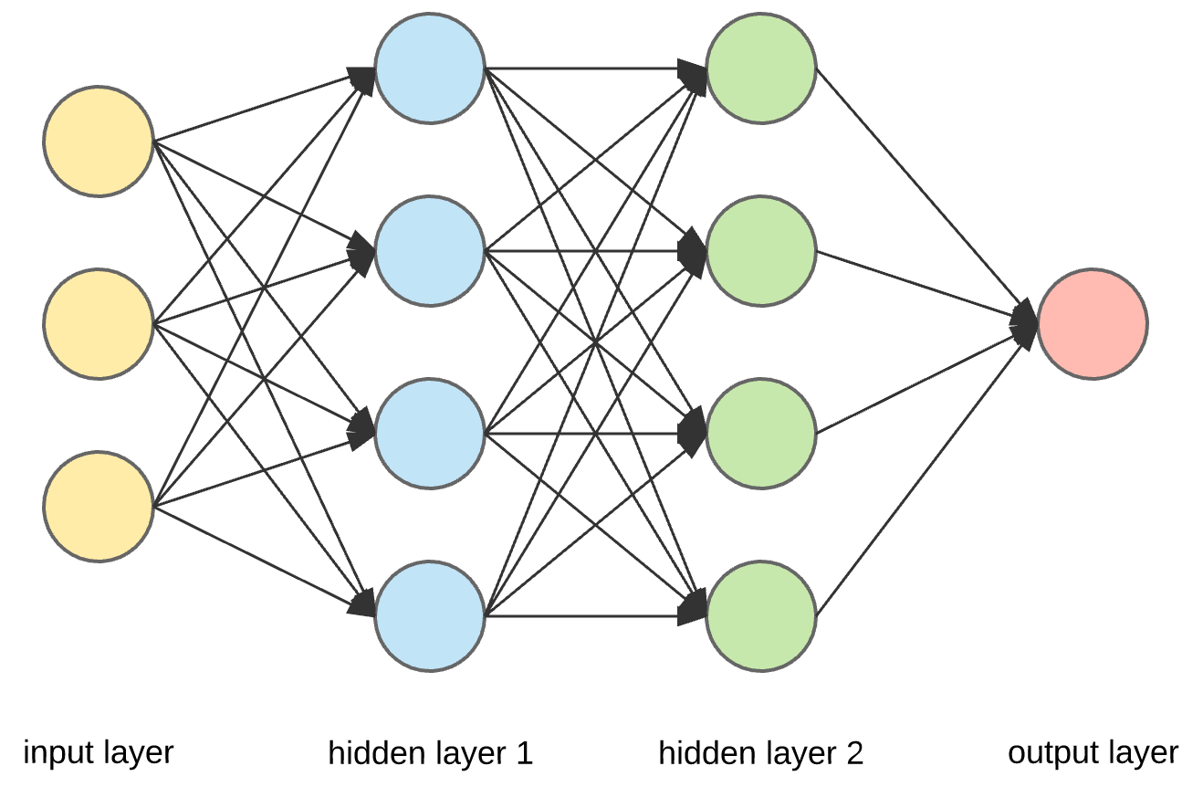
Neural Network
Complicated mathematical model based on weights
Interconnected nodes
Based on the basic functions of the brain

Slide 8
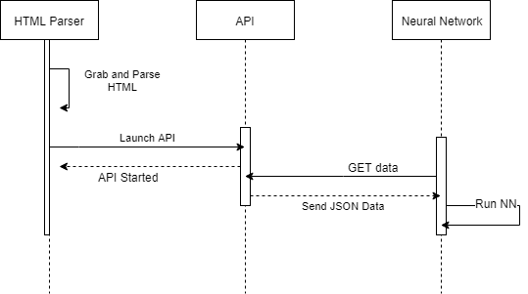
Tech Stack
Java 8
Maven
JSOUP
Spark
Python 3.6
Google’s Tensorflow (keras)

Slide 9


Okay….so the Point?
Countries rise and fall
34 new sovereign nations since 1990
The question to be answered:
How does economy contribute?

Slide 10

Current Project State
14 years have been parsed (2000 – 2013)
API is runnable on pi
Models with results of learning on the 14 years of data

Slide 11

The models
Models have been inputted with the following parameters:
Average Military budget growth rate
Average Unemployment Rate
Average GDP growth rate
Average Labor Force
Average Population
Average external debt
Average Import to Export Ratio
All Parameters were randomly inputted
Output was how many years the country was in the data

Slide 12
The Results

Slide 13

What’s Next
A lot of promise is being shown
Manually inputted data from other years had mixed results
Training, Training, and more Training
Different combinations and number of inputs may fair better

Slide 14

Thank You
Any questions?

